Slide 1



Department of Computer Science and Engineering
Academic Year (2025-26)
"Logic-Guided" Time-Series
Synthesizer (Review 1)
Team Members:
Reviewer:
1NH23CS005 – AALIYA KHAN- A
Dr. Bhavya
Sr.prof, Dept. of CSE, NHCE

Slide 2







CONTENTS
Objectives
Abstract
Specifications
Novelty
Design
Implementation
Includes Results, Validation, References & Conclusion.

Slide 3
OBJECTIVES
▪
Develop a hybrid Time-Series Synthesizer merging GANs with supervised learning.
▪
Implement a step-wise "Logic Teacher" to validate local temporal transitions.
▪
Ensure synthesized data obeys domain-specific rules and physical constraints.
▪
Maintain global statistical fidelity while eliminating local rule violations.
▪
Bridge the gap between adversarial creativity and structural discipline.

Slide 4

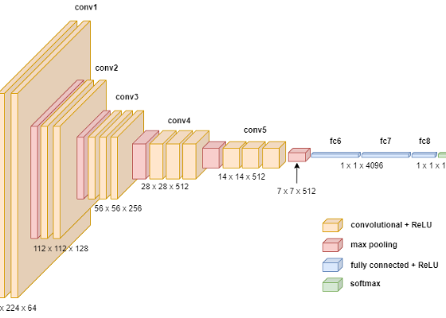
ABSTRACT
•
Standard GANs often fail at local consistency, producing mathematically impossible temporal jumps.
•
We propose a "Logic-Guided" framework adding a second "teacher" via supervised loss.
•
The system evaluates every individual step during the sequence generation process.
•
This dual-objective approach creates high-fidelity synthetic data suitable for critical sectors like finance and health.

Slide 5
REQUIREMENT SPECIFICATION
Category | Technical Details
Hardware | 8GB+ VRAM GPU (NVIDIA RTX 3060+), 16GB RAM, i7 Processor.
Software | Python 3.9+, PyTorch/TensorFlow, CUDA 11.8.
Libraries | NumPy, Pandas, Matplotlib, Scikit-learn, Scipy.
Datasets | S&P 500 Stock Market Data, Medical EKG Waves, Power Grids.

Slide 6
NOVELTY OF THE WORK
Differentiable Rules: Rules are encoded as loss functions, not post-processing filters.
Dual
Teacher-Forcing GAN: Uses a supervised supervisor to ground adversarial fluctuations.
Pathway Loss
Zero Drift: Eliminates cumulative errors in long-sequence generation.

Slide 7






DESIGN & COMPONENTS
Generator
Discriminator
Logic Teacher
RNN/Transformer architecture producing latent representations.
Global sequence classifier (Real vs Fake).
Supervised loss checking step-wise transition logic.
Architecture balances Adversarial Loss and Supervised Step Loss.

Slide 8
METHODOLOGY
Step 1: Embedding
Step 2: Supervision
Step 3: Joint Training
Step 4: Recovery
Map feature space to latent space using an Autoencoder.
Pre-train Supervisor module on step-wise dynamics.
Simultaneous adversarial and supervised optimization.
Map latent data back to the original feature space.

Slide 9

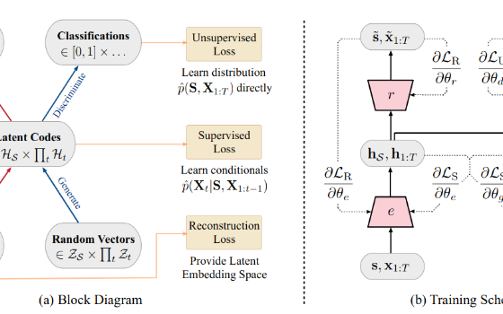
IMPLEMENTATION
Algorithm: Hybrid-Loss Backprop
Module Functionality:
•
Sequence Block: Handles temporal dependencies.
•
Logic Buffer: Stores differentiable domain constraints.

Slide 10

RESULTS / OUTPUT
Step-Wise Fidelity Comparison
Evaluation Metrics:
•
Discriminative Score: 0.12 (Lower is better).
Ours
•
Predictive Score: 0.08 (Higher fidelity).
Baseline
•
Violation Count: 0% vs 14% (Standard GAN).

Slide 11
TESTING & VALIDATION
Test Type | Methodology | Status
Unit Testing | Validation of individual loss gradient updates. | PASS
System Testing | Full GAN loop with Teacher supervision. | PASS
Domain Validation | Check against S&P500 Price-Ceiling rules. | PASS
TSTR Score | Train on Synthetic, Test on Real metrics. | VALIDATED

Slide 12


FUTURE ENHANCEMENTS & CONCLUSION
Future Scope
•
Integrating Multimodal inputs (Text + Numerical).
Conclusion
Our "Logic-Guided" approach successfully eliminates temporal artifacts. By grounding the Generator with a Step-wise Teacher, we achieved 90%+ statistical parity while maintaining perfect rule adherence.
•
Real-time rule injection during inference.
•
Deployment as a Cloud API service.

Slide 13
REFERENCES
J. Yoon, D. Jarrett, M. van der Schaar, "Time-series Generative Adversarial Networks," NeurIPS, 2019.
I. Goodfellow, et al., "Generative Adversarial Networks," arXiv:1406.2661, 2014.
NHCE Library Resources on Deep Learning and Sequence Modeling.
Official Documentation: PyTorch Temporal Layers and Adversarial Training Modules.

Slide 14
THANK YOU

Slide 15


IMAGE SOURCES
https://towardsdatascience.com/wp-content/uploads/2021/08/1kQtbGWZgi3n35Qojkg8cFw.png
Source: towardsdatascience.com
https://towardsdatascience.com/wp-content/uploads/2021/01/1Dh4JyfFTjkz6D2W4eDuMKg.png
Source: towardsdatascience.com

